Slide 1
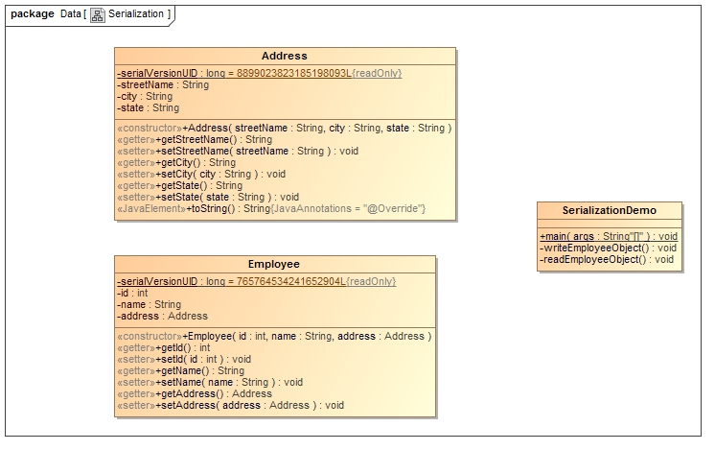
Java Serialization with Aggregation (HAS-A Relationship)
Employee has Address, so If Address is not Serializable, we cannot serialize the instance of Employee class.

